Slide 1
Generic Text categorization
Manas Ram Bapatla
(1001227169)
Rajiv Ravishankar
(1001213800)

Slide 2
http://omega.uta.edu/~vxg3135/classes/2015/fall/ai1/assmts/pa/pa7.html
Project Objective
To implement an efficient generic text categorization method that’s not domain specific by using Naïve bayes

Slide 3
Naïve bayes IMplementations
Gaussians
Histograms
Mixtures of Gaussians

Slide 4
About Naïve Bayes
The Naive Bayes algorithm is an intuitive method that uses the probabilities of each attribute belonging to each class to make a prediction.
Naive bayes simplifies the calculation of probabilities by assuming that the probability of each attribute belonging to a given class value is independent of all other attributes.
This is a strong assumption and results in a fast and effective method.

Slide 5
The paper talks about using Bayesian classifiers which uses a statistical pattern of word occurrences in a document to categorize text.
Compared to the Bayesian classifiers naïve bayes is better as it concentrates only on the area that is required.

Slide 6
About Gaussians distribution
This is a continuous probability distribution. It is mainly used in statistics and social sciences to represent real valued random members.
This is appropriate for those classes that have consistent normal distributions.
The naive Bayes classifier estimates a separate normal distribution for each class by computing the mean and standard deviation of the training data in that class

Slide 7
About Mixture of histograms

Slide 8
Dataset used
The data set used to implement naïve bayes is “Pima Indians Diabetes Data Set”.
This is found in the Machine learning repository (link: https://archive.ics.uci.edu/ml/datasets/Pima+Indians+Diabetes)
Number of Instances: 768
Number of Attributes: 8

Slide 9
The attributes are:
1. Number of times pregnant 2. Plasma glucose concentration a 2 hours in an oral glucose tolerance test 3. Diastolic blood pressure (mm Hg) 4. Triceps skin fold thickness (mm) 5. 2-Hour serum insulin (mu U/ml) 6. Body mass index (weight in kg/(height in m)) 7. Diabetes pedigree function 8. Age (years) 9. Class variable (0 or 1)

Slide 10
Assumptions made
Data set is split randomly into training and testing with a ratio of 67% and 33% randomly.
The input file is in .csv format
Language used is python.
Gaussian function used to estimate the probability of a given attribute value.

Slide 11
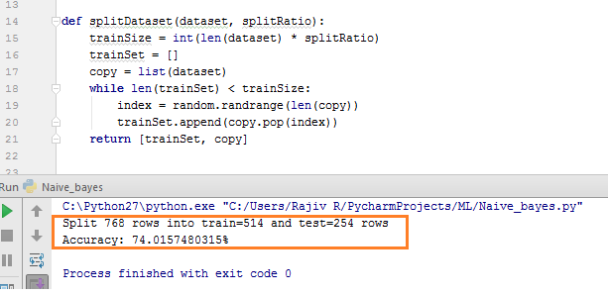
Results
Accuracy around 74-75%

Slide 12
Further work
Probably apply histogram distribution.
Try to implement bayseian classifier (if possible using libraries).

